Slide 1
Structure

Slide 2
Folder Structure
POM File Basics
Outline
Basic Commands and Goals
Dependencies Local Repo

Slide 3
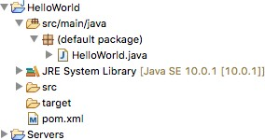
src/main/java
target pom.xml

Slide 4
Java Code
Package Declaration Other Languages Testing
src/main/java

Slide 5

Compilation Directory
Tests
Package Contents

Slide 6
pom.xml
<project xmlns="http://maven.apache.org/POM/4.0.0" xmlns:xsi="http://www.w3.org/2001/XMLSchema-instance" xsi:schemaLocation="http://maven.apache.org/POM/4.0.0
http://maven.apache.org/maven-v4_0_0.xsd">
<groupId>com.mycompany</groupId>
<artifactId>HelloWorld</artifactId>
<version>1.0-SNAPSHOT</version>
<modelVersion>4.0.0</modelVersion>
<packaging>jar</packaging>
</project>

Slide 7
Naming Convention
groupId, artifactId, version Dependencies section
Dependencies

Slide 8
pom.xml with new dependency
<project xmlns="http://maven.apache.org/POM/4.0.0" xmlns:xsi="http://www.w3.org/2001/XMLSchema-instance" xsi:schemaLocation="http://maven.apache.org/POM/4.0.0
http://maven.apache.org/maven-v4_0_0.xsd">
<groupId>com.mycompany</groupId>
<artifactId>HelloWorld</artifactId>
<version>1.0-SNAPSHOT</version>
<modelVersion>4.0.0</modelVersion>
<dependencies>
<dependency>
<groupId>org.apache.commons</groupId>
<artifactId>commons-lang3</artifactId>
<version>3.8.1</version>
</dependency>
</dependencies>
</project>

Slide 9
clean
compile package install deploy
Goals

Slide 10
Maven
Build Structure
Defaults

Slide 11
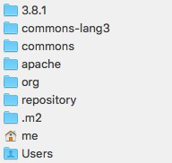
Maven storage
~/.m2/repository Stores artifact using info
<groupId>/<artifactId>/<version> Avoids duplication

Slide 12
src/main/java
target
Summary
Pom sections
Goals Dependency
~/.m2/repository Defaults

